Slide 1
SHORT-TERM ELECTRICAL LOAD FORECASTING FOR BANESHWOR FEEDER USING MACHINE AND DEEP LEARNING MODELS
Presenter,
Sujit Koirala
The Department Of Electrical Engineering
Masters Of Science In Power System Engineering
Tribhuvan University
Institute of Engineering
Pulchowk Campus

Slide 2
Table of contents
01
02
03
04
05
Introduction
Problem Statement
Objectives
06
07
Literature Review
Methodology
Conclusion
Future Work

Slide 3
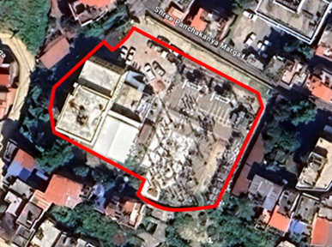
01
Introduction
Short-term electrical load forecasting is essential for planning and operating a reliable power system. It helps utilities manage demand, reduce costs, and improve overall efficiency. The Baneshwor Feeder serves a mix of households, businesses, and small industries, and its load pattern shifts with time, weather, and community activities. This project explores how modern machine learning and deep learning models can forecast its hourly demand more accurately than traditional methods.
Fig 1.1: Baneshwor Feeder View
Slide 1 - 1/16/2026

Slide 4
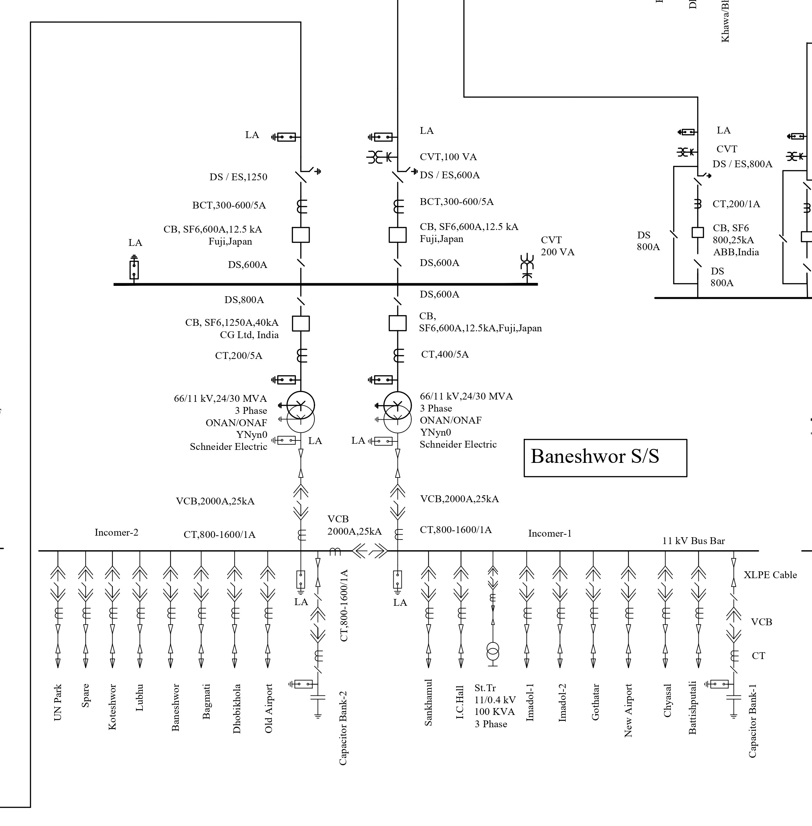
Fig 1.2: Substation & Transmission Line Network Baneshwor

Slide 5
Problem Statement
02
Existing forecasting methods for the Baneshwor Feeder rely on manual estimates or traditional statistical models that struggle to capture nonlinear and rapidly changing load patterns.
Weather changes, calendar effects, and local demand variations make the load behavior more complex, reducing the accuracy of current forecasting practices.
Inaccurate forecasts lead to poor generation scheduling, higher operational costs, increased technical losses, and potential reliability issues in the distribution system.
There is no systematic study that applies and compares advanced machine learning and deep learning models for short-term forecasting of this specific feeder.
Slide 2 - 1/16/2026

Slide 6
Objectives
03
Main Objective
To develop an accurate short-term electrical load forecasting model for the Baneshwor Feeder by integrating cleaned load data, weather variables, and advanced ML/DL techniques.
Specific Objective
To collect, clean, and standardize multi-year feeder load and weather data
To engineer meaningful temporal and weather-based features for forecasting
To compare the performance of ML models (LR, Ridge, SVR, RF, GBR, XGBoost)
To evaluate deep learning models (LSTM, GRU) using sequential forecasting methods
To identify the best-performing model based on RMSE, MAE, MAPE, and R²
To visualize load behavior across daily, weekly, and seasonal patterns
To prepare a final forecasting framework suitable for real-world feeder operations
Slide 3 - 1/16/2026

Slide 7
Literature Review
04
S.N. | Author(s) & Year | Models Used | Input Features | Dataset / Study Area | Key Findings | Research Contribution
1 | Singla et al. (2019) | ANN | Dew point, dry bulb temperature, humidity | Power system dataset | ANN effectively captured nonlinear relation between weather and load | Demonstrated ANN suitability for STLF
2 | Desai et al. (2021) | Prophet (Meta) | Time, temperature, humidity, weather forecast | Electrical load data | Prophet handled seasonality and missing data efficiently | Introduced statistical ML hybrid for STLF
3 | Matrenin et al. (2022) | XGBoost, AdaBoost, RF, SVR, DT | Historical load data | Isolated power systems | Gradient boosting models outperformed traditional ML | Highlighted superiority of ensemble boosting
4 | Aguilar Madrid & Antonio (2021) | RF, SVR, XGBoost | Load history, weather, holidays | Regional power system | XGBoost achieved highest accuracy | Justified tree-based ensemble models
5 | Guo et al. (2021) | SVM, RF, LSTM, Ensemble | Load and weather features | Large-scale power system | Fusion of ML and DL improved accuracy | Motivated ensemble forecasting strategies
Slide 4 - 1/16/2026

Slide 8
Literature Review
04
S.N. | Author(s) & Year | Models Used | Input Features | Dataset / Study Area | Key Findings | Research Contribution
6 | Saglam et al. (2024) | ANN, SVR + PSO, DO, GRO | Load, GDP indicators | Power system dataset | ANN + Growth Optimizer performed best | Linked optimization techniques with ML
7 | Jain & Gupta (2024) | SVM, LSTM, RNN, Ensembles | Preprocessed load data | Electrical grid dataset | Ensemble and DL models outperformed statistical methods | Emphasized preprocessing and feature selection
8 | Chapagain et al. (2021) | ML, DL (LSTM) | Load history, temperature, day type | Kathmandu Valley, Nepal | LSTM showed lowest MAPE and RMSE | Nepal-based validation of DL models
9 | Acharya et al. (n.d.) | RNN | Historical load features | Gothatar Feeder, Nepal | RNN outperformed exponential smoothing methods | Feeder-level DL forecasting in Nepal
10 | Cordeiro-Costas et al. (2023) | RF, SVR, XGBoost, MLP, LSTM, Conv-1D | Load and weather data | Power system dataset | LSTM achieved lowest forecasting error | Compared CNN and RNN architectures
Slide 5 - 1/16/2026

Slide 9
Methodology
05
01
02
03
04
06
07
Data
Acquisition
Data
Preprocessing
Exploratory
Data Analysis
Model Development
Model Training
& Validation
Performance Evaluation
Collect raw load and weather data
Clean, align, and standardize all data
Understand patterns, trends, correlations
Design ML/DL forecasting models
Train models and tune parameters
Compare models using error metrics
Slide 6 - 1/16/2026

Slide 10
Data Acquisition & Preprocessing
5.1
Load Data: Hourly MW readings from Baneshwor Feeder.
Weather Data: Temperature, Humidity, and Rainfall.
Challenges: Missing Value, Nepali (BS) Date Format, Outliers
Standardization: Converted all timestamps to Gregorian (AD).
Cleaning: Handled missing values via Forward/Backward fill; detected outliers using IQR.
Feature Engineering: Created Hour, Day, Month and Time Features from time.
Slide 7 - 1/16/2026

Slide 11
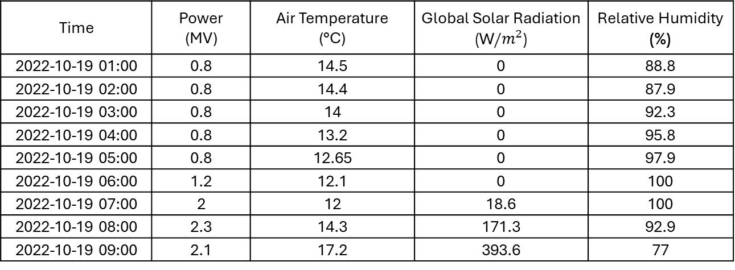
Data Acquisition & Preprocessing
5.1
Time | Power (MV) | Air Temperature (°C) | Global Solar Radiation (W/$m^{2}$) | Relative Humidity (%)
2022-10-19 01:00 | 0.8 | 14.5 | 0 | 88.8
2022-10-19 02:00 | 0.8 | 14.4 | 0 | 87.9
2022-10-19 03:00 | 0.8 | 14 | 0 | 92.3
2022-10-19 04:00 | 0.8 | 13.2 | 0 | 95.8
2022-10-19 05:00 | 0.8 | 12.65 | 0 | 97.9
2022-10-19 06:00 | 1.2 | 12.1 | 0 | 100
2022-10-19 07:00 | 2 | 12 | 18.6 | 100
2022-10-19 08:00 | 2.3 | 14.3 | 171.3 | 92.9
2022-10-19 09:00 | 2.1 | 17.2 | 393.6 | 77
Table 4.1 Finalized Sample Dataset
Slide 8 - 1/16/2026

Slide 12
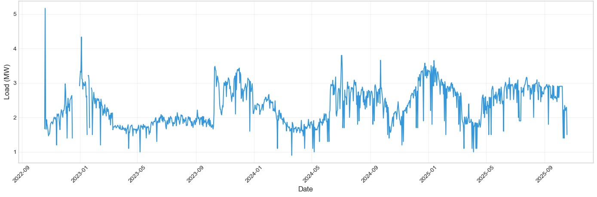
Exploratory Data Analysis
5.2
Fig 4.1 Load Curve
Slide 9 - 1/16/2026

Slide 13
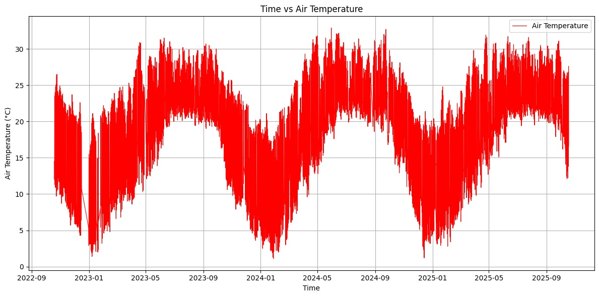
Exploratory Data Analysis
5.2
Slide 10 - 1/16/2026
Fig 4.4 Air Temperature in different time
Slide 11 - 1/16/2026

Slide 14
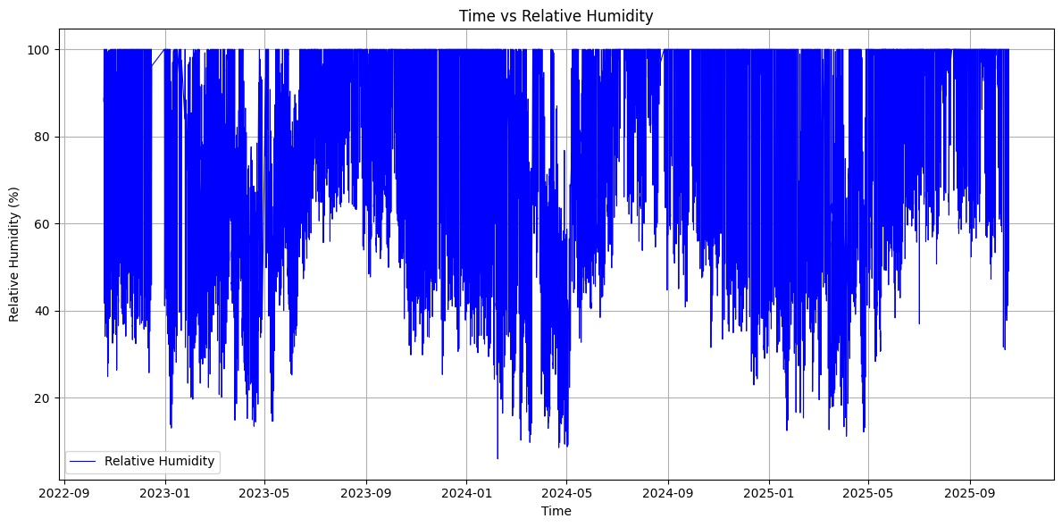
Exploratory Data Analysis
5.2
Slide 10 - 1/16/2026
Fig 4.5 Relative Humidity in different time
Slide 12 - 1/16/2026

Slide 15
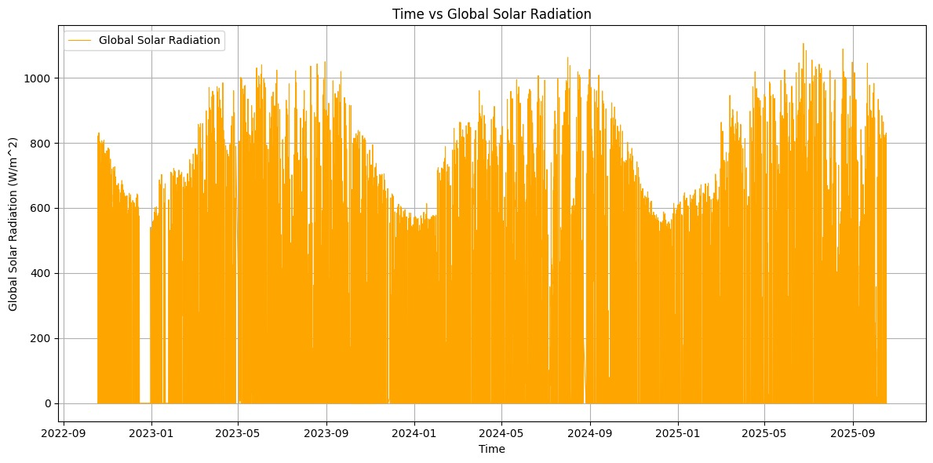
Exploratory Data Analysis
5.2
Slide 10 - 1/16/2026
Fig 4.6 Global Solar Radiation in different time
Slide 13 - 1/16/2026

Slide 16
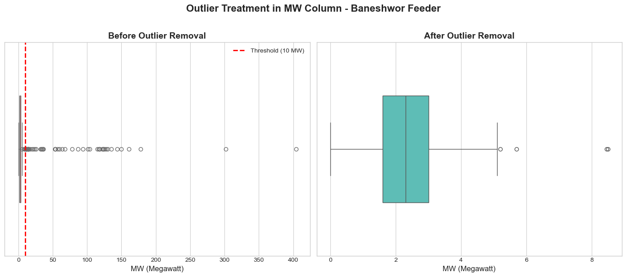
Exploratory Data Analysis
5.2
Slide 10 - 1/16/2026
Fig 4.7 Outlier Treatment in Power (MW) Column
Slide 14 - 1/16/2026

Slide 17
Exploratory Data Analysis
5.2
Slide 10 - 1/16/2026
Statistic | Value
Mean | 2.3483 MW
Median | 2.3000 MW
Standard Deviation | 0.9186 MW
Variance | 0.8438 MW²
Minimum | 0.0000 MW
Maximum | 8.5000 MW
Table 4.2 Descriptive Statistics of MW Column after outlier Removal
Slide 14 - 1/16/2026

Slide 18
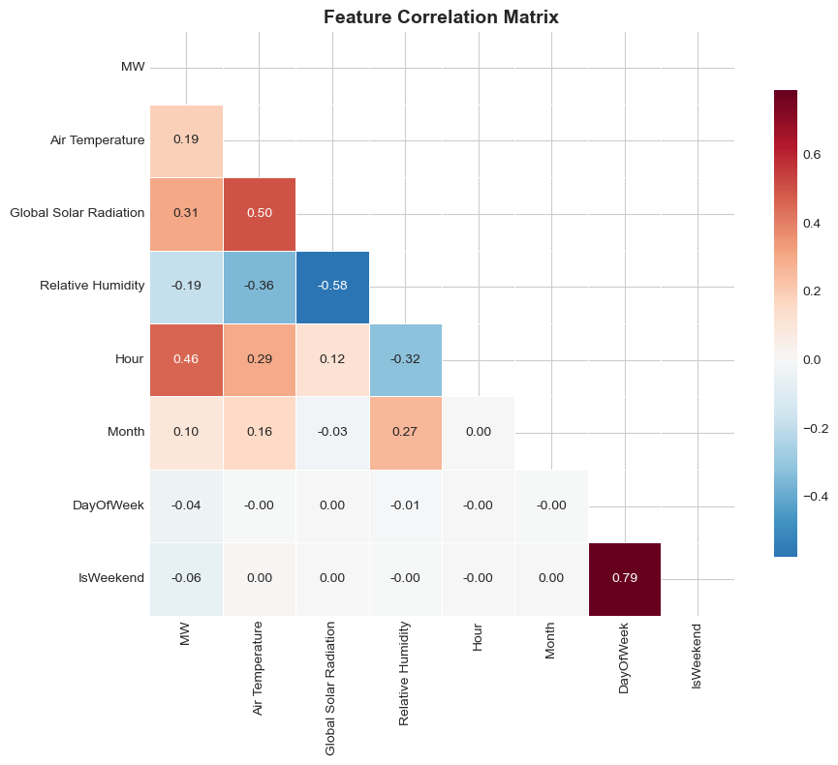
Exploratory Data Analysis
Slide 11 - 1/16/2026
5.2
This correlation matrix shows how different all the columns in the data are related to reach other.
Fig 4.4 Correlation Matrix
Slide 15 - 1/16/2026

Slide 19
5.3
Model Development & Training
Machine Learning Models
Deep Learning Model
XGboost
Random Forest
Gradient Boosting
SVR (Support Vector Regression)
Ridge Regression
Linear Regression
LSTM (Long Short-Term Memory)
GRU (Gated Recurrent Unit)
Slide 16 - 1/16/2026

Slide 20
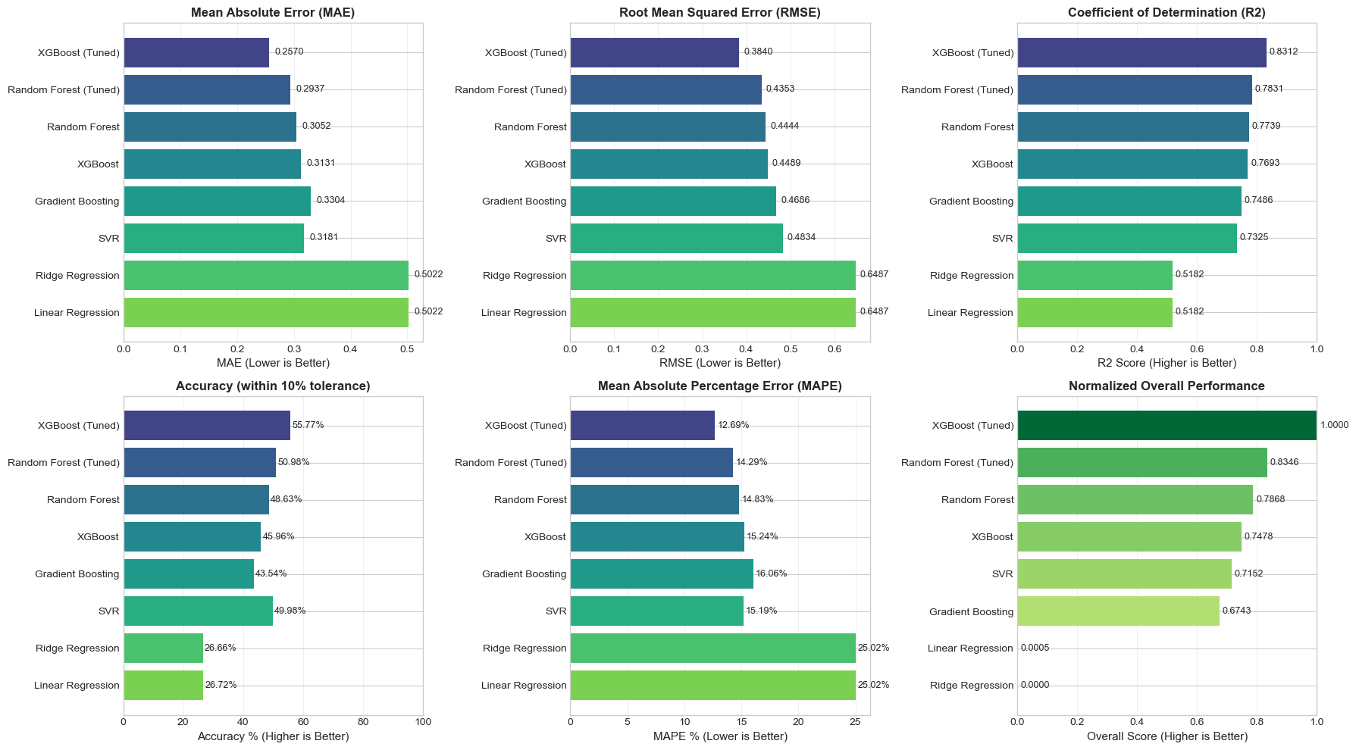
5.4
Performance Evaluation
Machine Learning Models
Tuned XGBoost is the most accurate performer with the lowest error rates (MAE of 0.2570 and RMSE of 0.3840).
Fig 4.5 Machine Learning Models Evaluation Results
Slide 17 - 1/16/2026

Slide 21
5.4
Performance Evaluation
Machine Learning Models
Fig 4.5 Machine Learning Models Evaluation Results
Tuned XGBoost is the clear winner, achieving the highest accuracy ($R^{2}$ of 0.8312) and the lowest average error rate (12.69%).
Slide 18 - 1/16/2026

Slide 22
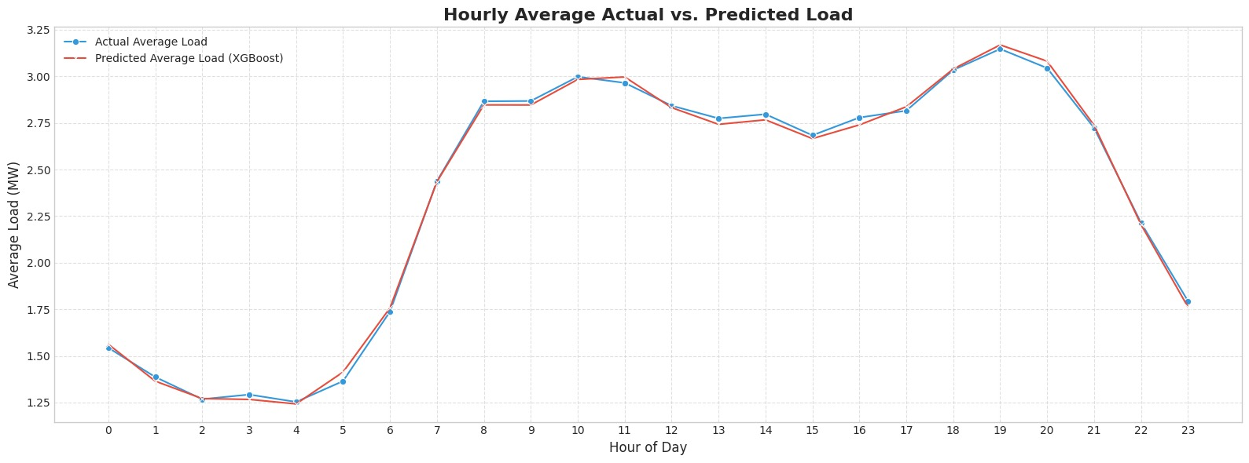
Performance Evaluation
5.4
Machine Learning Models
Fig 4.6 Machine Learning Models Actual vs Predicted Load
The top-performing machine learning models XGBoost.
Slide 19- 1/16/2026

Slide 23
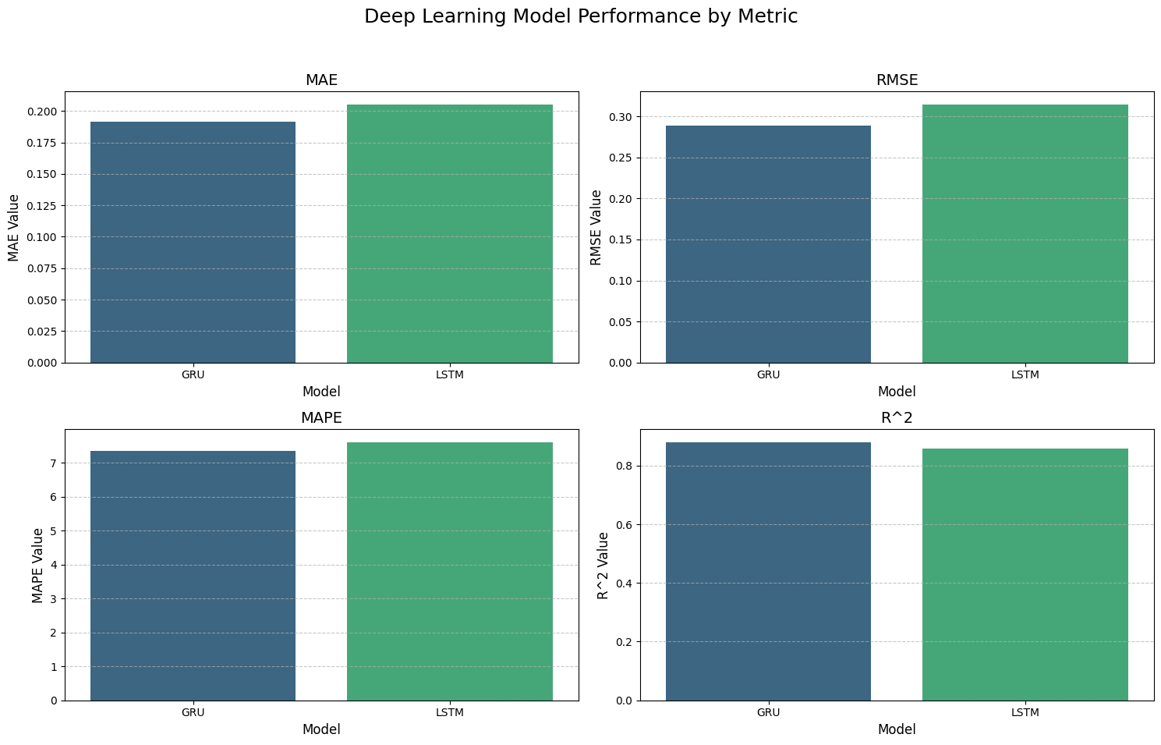
5.4
Performance Evaluation
Deep Learning Models
Fig 4.7 Deep Learning Models Evaluation Results
Slide 20 - 1/16/2026

Slide 24
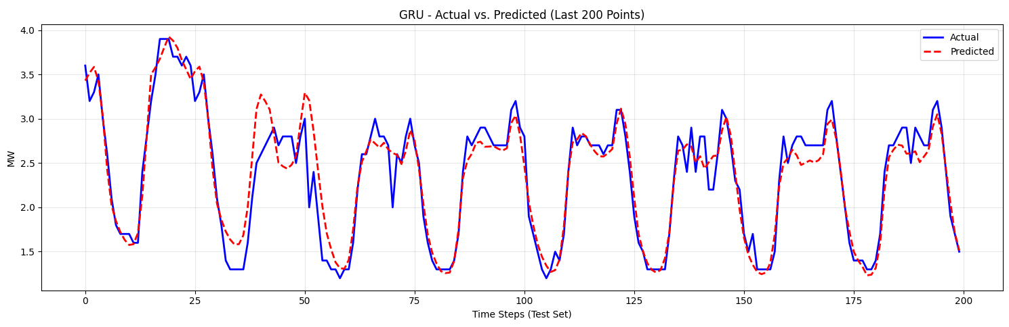
Performance Evaluation
5.4
Deep Learning Models
Fig 4.7 MLP Model Sample Forecast vs Actual
This graph compares real-world electricity usage (Actual) against an GRU model's predictions
Slide 21 - 1/16/2026

Slide 25
5.4
Performance Evaluation
Over All Model Ranking
Rank | Model | Type | MAE | RMSE | MAPE (%) | R²
1 | GRU | DL | 0.192 | 0.289 | 7.364 | 0.879
2 | LSTM | DL | 0.205 | 0.314 | 7.612 | 0.857
3 | XGBoost (Tuned) | ML | 0.257 | 0.384 | 12.693 | 0.831
4 | Random Forest (Tuned) | ML | 0.294 | 0.435 | 14.290 | 0.783
5 | Random Forest | ML | 0.305 | 0.444 | 14.825 | 0.774
6 | XGBoost | ML | 0.313 | 0.449 | 15.242 | 0.769
7 | Gradient Boosting | ML | 0.330 | 0.469 | 16.062 | 0.749
8 | SVR | ML | 0.318 | 0.483 | 15.193 | 0.732
9 | Ridge Regression | ML | 0.502 | 0.649 | 25.021 | 0.518
10 | Linear Regression | ML | 0.502 | 0.649 | 25.021 | 0.518
Table 4.2 ML and DL over all Models Ranking
Slide 22 - 1/16/2026

Slide 26
Conclusion
6
The study demonstrates that data-driven machine learning and deep learning models provide accurate short-term load forecasting at the feeder level by effectively capturing nonlinear and temporal demand patterns.
Recurrent neural network models outperformed traditional methods, with the GRU model achieving the best performance, followed closely by LSTM, due to their ability to learn long-term temporal dependencies.
Among machine learning approaches, the tuned XGBoost model delivered the best results, offering a strong balance between forecasting accuracy and computational efficiency.
The proposed forecasting framework is practical for real-world deployment and can support improved operational planning, reliability, and decision-making in power distribution systems.
Slide 23 - 1/16/2026

Slide 27
Future Work
7
The proposed forecasting framework can be extended to multiple feeders beyond the Baneshwor feeder to evaluate its scalability and wider applicability.
While this study focuses on short-term load forecasting, future work can explore medium- and long-term load prediction for better planning and decision-making.
The model performance can be further improved by using a longer historical dataset covering more years of load and weather data.
Slide 24 - 1/16/2026

Slide 28
Thanks!
Do you have any questions?
Presenter,
Sujit Koirala
The Department Of Electrical Engineering
Masters Of Science In Power System Engineering
Tribhuvan University
Institute of Engineering
Pulchowk Campus

Slide 29
References
Acharya, S., Luintel, M. C., & Badrudoza, M. (n.d.). Short-term load forecasting of Gothatar feeder of Nepal Electricity Authority using Recurrent Neural Network. Publisher not specified.
Desai, S., Dalal, T., Kadam, S., & Mishra, S. (2021). Electrical load forecasting using machine learning. IEEE (ICSCAN 2021).
Singla, M. K., Gupta, J., Nijhawan, P., & Oberoi, A. S. (2019). Electrical load forecasting using machine learning. International Journal.
Saglam, M., Lv, X., Spataru, C., & Karaman, O. A. (2024). Instantaneous electricity peak load forecasting using optimization and machine learning. Energies.
Matrenin, P., Safaraliev, M., Dmitriev, S., Kokin, S., Ghulomzoda, A., & Mitrofanov, S. (2022). Medium-term load forecasting in isolated power systems based on ensemble machine learning models. Energy Reports.
Aguilar Madrid, E., & Antonio, N. (2021). Short-term electricity load forecasting with machine learning. Information.
Cordeiro-Costas, M., Villanueva, D., Eguía-Oller, P., Martínez-Comesaña, M., & Ramos, S. (2023). Load forecasting with machine learning and deep learning methods. Applied Sciences.
Guo, W., Che, L., Shahidehpour, M., & Wan, X. (2021). Machine-learning-based methods in short-term load forecasting. The Electricity Journal.
Chapagain, K., Acharya, S., Bhusal, H., Katuwal, S., Lakhey, O., Neupane, P., Sah, R. K., Tamang, B., & Rajbhandari, Y. (2021). Short-term electricity demand forecasting for Kathmandu Valley, Nepal. Kathmandu University Journal of Science, Engineering and Technology.

